Slide 1
NASA Research Access and Persistent Identifiers
Gerald Steeman
Scientific and Technical Information Program
ESIP Information Quality Cluster Monthly Meeting (2/23/2021)

Slide 2
NASA’s Scientific and Technical Information Program (STI)
The STI Program is accountable for one of NASA’s greatest products: Results from NASA funded R&D research
The Mission of the STI Program is to support the advancement of aerospace knowledge and contribute to U.S. competitiveness in aerospace research and development.
The STI Program is chartered to
“Provide for the widest practicable and appropriate dissemination of information concerning [NASA’s] activities and the results thereof” (Space Act § 20112)
Ensure appropriate release restrictions are applied to STI (ITAR, EAR, patents, etc.)
Set policy and procedures for Agency-wide STI collection and management

Slide 3
STI is Integral to NASA’s R&D Success

Slide 4
My (selfish) goal for this meeting:
Provide awareness of the Research Access activity and PIDs and then get more back in feedback from the IQC.

Slide 5
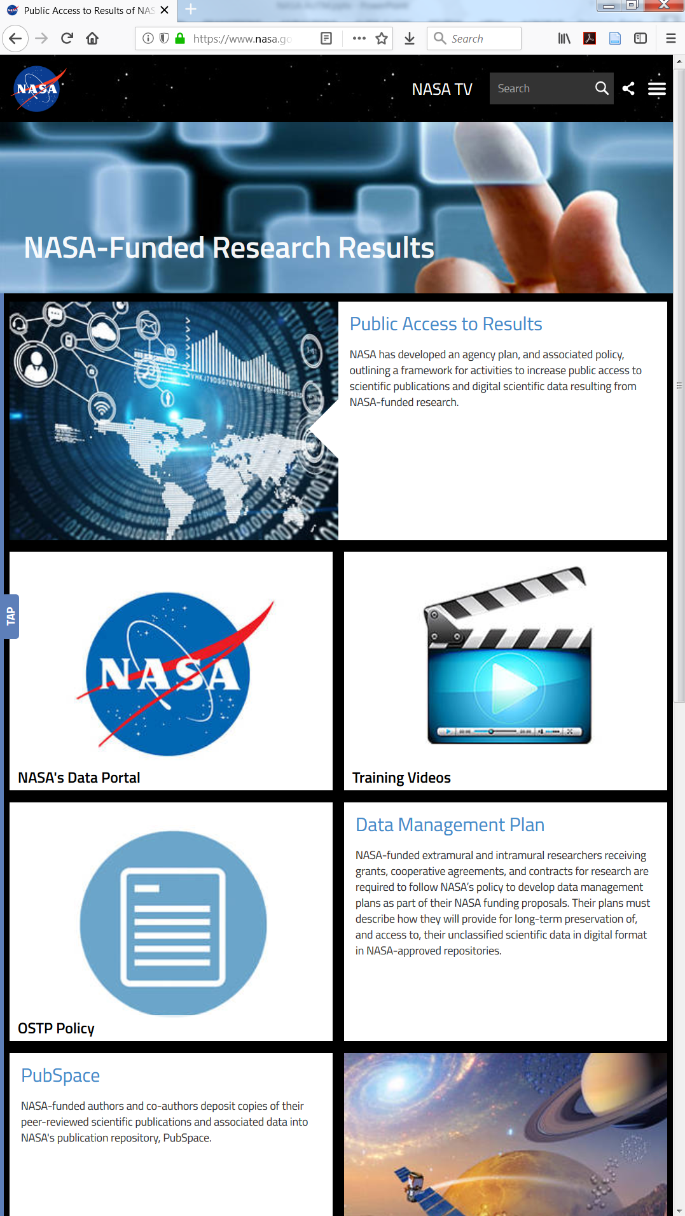
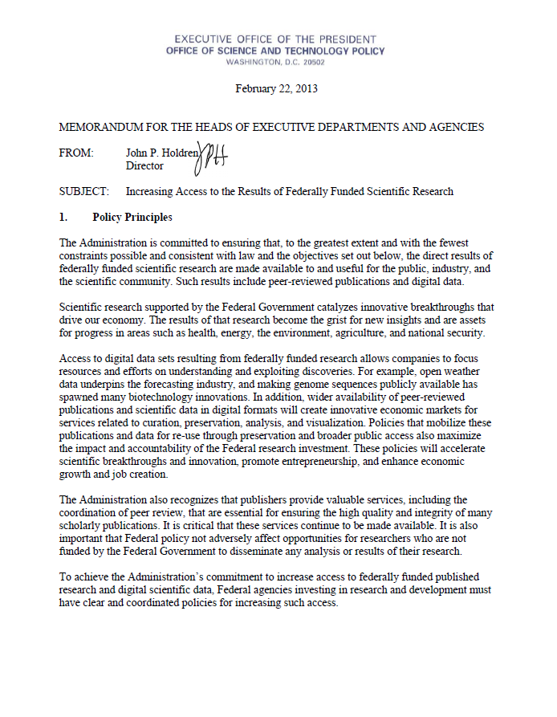
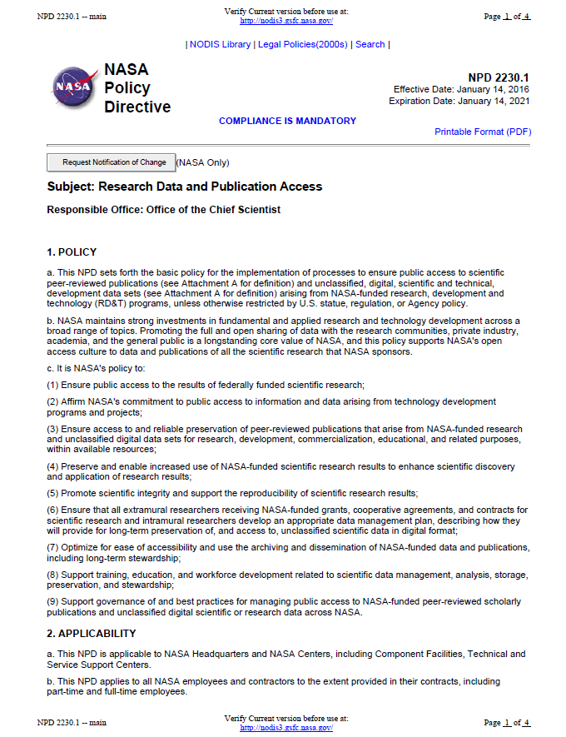
Emphasis on Public Access In Policy
2013
2014
2016
2016
https://bit.ly/2zpmRuW
Increasing Access to the Results of Federally Funded Research (OSTP Memo) directed “Federal agenc[ies] ….to develop a plan to support increased public access to the results of research funded by the Federal Government.”
https://go.nasa.gov/2HZZyRL
NASA Plan for Increasing Access to the Results of Scientific Research served as the Agency’s response:
Data Management Plans
Catalog of Datasets
Adopt NIH’s PMC for Accepted Manuscripts (NASA PubSpace)
https://go.nasa.gov/2TDZaJO
NPD 2230.1 Research Data and Publication Access is the key NASA policy document directing the implementation of the NASA Plan and laying out responsibilities
https://go.nasa.gov/2SiRXCw
Research Access Website and “PubSpace” are the first pieces in implementing the plan and keys to realizing a full Open Science architecture.
Notes:
Grants Terms and Conditions approved for use starting 11/28/16. Federal Register Vol. 81, No. 208 pp.74657-9

Slide 6
Research Access Project
Project: The Research Access (RA) Project sets out to fulfill objectives set out in the NPD 2230.1 “Research Data and Publication Access”
Description: The focus Research Access going forth is “to ensure public access to scientific peer-reviewed publications and unclassified, digital, scientific and technical, development data sets arising from NASA-funded research, development and technology (RD&T) programs, unless otherwise restricted by U.S. statue, regulation, or Agency policy.”

Slide 7
Research Access Scope Main Elements*
Publications
Data Products
Research data are defined as the recorded factual material commonly accepted in the scientific community as necessary to validate research findings
Data are understood to include not only the recorded technical information, but also
Data Management Plans (DMP)
Data sharing and preservation to enable validation of published results
Cover research data that underlie the results and findings in peer-reviewed publications
Assessed at research proposal and project plan reviews.
Monitored for compliance by NASA program managers
metadata (describing the data)
descriptions of the software required to read and use the data
associated software documentation
associated data (e.g., calibrations).
Satisfy by submitting an exact copy of the accepted manuscript on acceptance by the publisher; or, if the publisher has an agreement in place with the repository to later transmit the edited and formatted Version of Record (VoR) to the repository
Required annual and final reporting requirements for awardees regarding publications will be defined in the award instrument.
The defined applicability to “peer-reviewed publications” focuses on journal articles.
Core elements outlined in NASA Plan
*Derived from: NP-2015-05-1796-HQ NASA Plan for Increasing Access to the Results of Scientific Research
Notes:
Derived from: NP-2015-05-1796-HQ NASA Plan for Increasing Access to the Results of Scientific Research

Slide 8
Research Access Project Goals “Promoting the full and open sharing of data with the research communities, private industry, academia, and the general public is a longstanding core value of NASA, and this policy supports NASA's open access culture to data and publications of all the scientific research that NASA sponsors.” [NPD 2230.1, 1.b]
Facilitate the collection of NASA-funded peer-reviewed publications and corresponding research data
Support discovery and use of NASA-funded peer-reviewed publications and corresponding research data
Coordinate with stakeholders to ensure the cohesive management of these products in the research cycle
Plan: Minimum Viable Product
1
Create External Submission Portal for STI/RA Deliverables-(PID-Enabled)
2
Build on PIDs for discovery
3
Build on PIDs for research management

Slide 9
External Submission Portal (Enabled by Persistent Identifiers)
Description: NASA-supported interface that allows researchers without NASA network identities to submit research deliverables defined in NPR 2200.2 (STI) and NPD 2230.1 (RA).
Functionality:
Leverage ORCID and guest.nasa.gov as login credentials
Associate funding award/code with each submission
Curate for public release (NASA and partners)
Assign DOI for each public-released, NASA version

Slide 10
Persistent Identifier Services (PIDS) Project Roadmap & Delivery Goals
MVP
STRIVES
Optimize
STRIVES
Extend Services
Other NASA Organizations
ORCID-enabled External Submssion Portal
Enrich submissions with other metadata sources such as CrossRef
Expand relationships with Open Access publication source such as CHORUS
Develop process for provisioning PID Services for other repositories and systems
Provide mediated PID Services for lower-volume use cases
Optional ORCID for Intramurals via NF-1676
DataCite DOIs assigned to publicly-available releases
Attribute validated funding/project code to each submission
Leverage ORCID and DataCite for search and discovery services
Accepted submission citations written back to ORCID accounts
Refine funding and organizational reporting features
Evaluate NIH’s PMC services
FY21 Q3
FY21 Q4
FY22 Q1

Slide 11
Persistent Identifier Services (PIDS) Extend Services
Develop process for provisioning PID Services for other repositories and systems
Provide mediated PID Services for lower-volume use cases
Leverage ORCID and DataCite for search and discovery services
Extend Services
Other NASA Organizations
Will offer ORCID and DataCite initially
Other PID services to investigate:
Research Organization Registry (ROR.org)
Grant ID (CrossRef.org effort)
DataCite: Repository account; dashboard and API services; create/edit DOI records; test and production
ORCID: API services; sandbox and production
Considering NAMS process for requesting access to services and provisioning management
FY22 Q1

Slide 12
Next Steps
Current focus is on the External Submission System and integrating PID Services into that process (FY21)
Build lessons learned and gather user needs for other research management process owners (FY21-FY22)
Develop standard practices guidance and associated services for PIDs (FY22)

Slide 13
Discussion
Now
OR
Later
Gerald.Steeman@nasa.gov

Slide 15
What’s a PID?
A persistent identifier (PID) is an ongoing, long-lasting digital reference to a resource.
An identifier is a label which gives a unique name to an entity: a person, place, or thing. Unlike URLs, which may break, a persistent identifier reliably points to a digital entity. Digital object identifiers (DOIs) are persistent identifiers for entities such as journal articles, books, and datasets. You may have heard of ORCID iDs, which are persistent identifiers for researchers, and DataCite, which assigns DOIs for datasets. Learn more about the critical role of the DOI.
Crossref, ORCID, DataCite, and many other PID organizations work together to build trusted connections between DOIs, ORCID iDs, and other identifiers.
Each DOI is associated with a metadata record, giving information about the work. A DOI becomes active once it and its metadata record have been registered with Crossref - learn more about content registration. Though the DOI doesn’t change, its associated metadata is kept up-to-date by the owner of the record.
PID map: identifying and linking research elements. We identify researchers using ORCID iDs, works using DOIs, research institutions using Organization IDs (ROR), and funders using Funder IDs. Grant IDs identify grants, and research equipment and materials. Having uniquely identified each element, we include relevant PIDs in the metadata of each element. The links show the relationships between the elements, and allow us to see how they are connected in time and space.
From: https://www.crossref.org/education/metadata/persistent-identifiers/

Slide 16
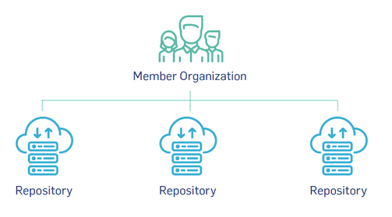
DataCite – datacite.org
A Digital Object Identifier (DOI) is an alphanumeric string assigned to uniquely identify an object. It is tied to a metadata description of the object as well as to a digital location, such as a URL, where all the details about the object are accessible.
https://gis1.servirglobal.net/TrainingMaterials/SAR/SARHB_FullRes.pdf
NASA
NASA.DATA
NASA.GENELAB
NASA.STI

Slide 17
ORCID – orcid.org
The ORCID iD is an https URI with a 16-digit number that is compatible with the ISO Standard (ISO 27729), also known as the International Standard Name Identifier (ISNI), e.g. https://orcid.org/0000-0002-1825-0097

Slide 18
Commonly Used Acronyms
DOI – (Digital Object Identifier) a unique alphanumeric string assigned by a registration agency to identify content and provide a persistent link to its location on the Internet
DMP – (Data Management Plan) a written document that describes the types of data a researcher expects to generate during the course of a research project, how the data will be managed, described, and analyzed, how the data will be stored, and what channels will be used at the end of the project to share and preserve the data.
FAIR Principles - Findability, Accessibility, Interoperability, and Reuse of digital assets. The principles emphasize machine-actionability (i.e., the capacity of computational systems to find, access, interoperate, and reuse data with none or minimal human intervention) https://www.go-fair.org/fair-principles/
NIH – (National Institutes of Health) NASA chose to partner with the NIH to release and share NASA funded research into a collaborative archive, NASA PubSpace, housed within NIH’s PubMed Central repository
NID – NASA Interim Directive NPD – NASA Policy Directive
NPR – NASA Procedural Requirement
ORCID – (Open Researcher and Contributor ID) is a nonproprietary alphanumeric code to uniquely identify scientific and other academic authors and contributors
ROR – Research Organization Registry
Notes:
Research Access - public access to scientific peer-reviewed publications and unclassified, digital, scientific and technical, development data arising from NASA-funded research, development and technology programs, unless otherwise restricted by U.S. statue, regulation, or Agency policy
Accepted Manuscript - The version of a journal article that has been peer-reviewed and accepted for publication, and includes changes made by the author during the peer-review process. The content is the same as the published article, but it does not have the final formatting and copy-editing done by the publisher in the final published version, and it is not a reproduction copy of what appears or will appear in the journal; it is not a reprint of the published article.
DOI – (Digital Object Identifier) a unique alphanumeric string assigned by a registration agency to identify content and provide a persistent link to its location on the Internet
DOIMS - Digital Object Identifier Management System
DMP – (Data Management Plan) a written document that describes the types of data a researcher expects to generate during the course of a research project, how the data will be managed, described, and analyzed, how the data will be stored, and what channels will be used at the end of the project to share and preserve the data.
ORCID – (Open Researcher and Contributor ID) is a nonproprietary alphanumeric code to uniquely identify scientific and other academic authors and contributors
ORCID/Funding Manager (Grant Manager) – internal STI application that houses the grant information necessary for publication submission to NIHMS
NIH – (National Institutes of Health) NASA chose to partner with the NIH to release and share NASA funded research into a collaborative archive, NASA PubSpace, housed within NIH’s PubMed Central repository
Extramural – NASA funded grantees
Intramural – NASA civil servants and contractors

Slide 19
Commonly Used Terms and Definitions
Accepted Manuscript - The version of a journal article that has been peer-reviewed and accepted for publication, and includes changes made by the author during the peer-review process. The content is the same as the published article, but it does not have the final formatting and copy-editing done by the publisher in the final published version, and it is not a reproduction copy of what appears or will appear in the journal; it is not a reprint of the published article.
Digital Object – A data structure whose principal components are digital material, or data, plus a unique identifier for this material.
Extramural – NASA funded grantees
Intramural – NASA civil servants and contractors
NASA-funded research: any NASA funded research, including research partially funded by NASA and sub-awards of NASA funding​
PubSpace: NASA’s publication repository within PMC​
STI Repository: NASA’s online repository that provides access to NASA’s research and development including aerospace-related citations, full-text online documents, images and videos.
Research Access - public access to scientific peer-reviewed publications and unclassified, digital, scientific and technical, development data arising from NASA-funded research, development and technology programs, unless otherwise restricted by U.S. statue, regulation, or Agency policy

