Slide 1
VISUALISING AUSTRALASIA’S SOILS:
Application and challenges of applying controlled vocabularies for standardising soils data
November 2020. ESIP Soil Ontology Working Group
Project Lead: Peter Dalhaus Presenter: Megan Wong
Wong, M.R, Simons, B., MacLeod, A., Gillett, H. et al. CeRDI, Federation University
With acknowledgements to the contribution of whole project team and participants including Grower Groups and CMAs

Slide 2
Our role -
Primarily data brokers for development of data platforms and tooling
Users of controlled vocabularies (and where necessary creators and managers)
What we are using controlled vocabularies for –
Standardisation of soil data provided from soil data providers
  Focus: farming grower groups and Catchment Management Authorities
- Data received from providers as excel sheets, content not in standard structure
- Results are from laboratories across country
- Measurements and results are not described in standard ways (methods may be National standards but data is not labelled in a standard way or with persistent identifiers)
- No standards for contextual data fields and content (some datasets well described, some not)
Focus of this talk –
How we are using controlled vocabularies to standardise this data
Challenges encountered as vocabulary users
Our current approach/solutions to the challenges
Note – much presented here is currently in development.
There will be things to fix. Suggestions welcome for v2!

Slide 3





Project/initiatives underway contributing that contribute to this work, delivering -
1. soil observations at depth data
2. soil profile data
Soil monitoring network and soil health knowledge base
https://data.soilcrc.com.au/map/about
https://www.agrefed.org.au/
Data Policies etc – AgReFed Zenodo community
https://www.ccmaknowledgebase.vic.gov.au/soilhealth/

Slide 4
Focus: Visualising Australasia’s Soils (“VAS”) – The Soil CRC
Interoperable spatial knowledge system providing Soil CRC participants, and the broader agricultural industry, with access to data, information and knowledge on Australasian soils.
Focus of vocabulary work to date: Grower groups and Catchment Management Authorities as data providers and users
  Birchip Cropping Group (VIC)
  Burdekin Productivity Services (QLD)
  Central West Farming Systems (NSW)
  Gillamii Centre (WA)
  Herbert Cane Productivity Services (QLD)
  Holbrook Landcare Network (NSW)
  Liebe Group (WA)
  MacKillop Farm Management Group (SA)
  Mallee Sustainable Farming (VIC)
  North Central Catchment Management Authority (VIC)
  Riverine Plains (NSW)
  Southern Farming Systems (VIC)
  WA No-Tillage Farmers Association (WA)
  West Midlands Group (WA)
  Wimmera Catchment Management Authority (VIC)
VAS
grower groups
farmers
researchers
agronomists
agribusiness
government
https://data.soilcrc.com.au/map/about

Slide 5
Through standardisation, controlled vocabularies to help deliver on provider/user use cases though the platform
Search and discovery for decision making
      For underpinning on-farm decision making
        See trends across space and time
        View data in context with other data at the local, regional, state and national level
Communication, context and trust
      Get a big picture of farm and region activities
      Connect projects – historical and current, on varying topics
      Avoid duplication, direct new work
      Finding out what other growers and groups are doing
      For funding applications, banking, insurance
      Will others understand its context?
      Will data be interpreted correctly (and decisions made on that) if there is no need to contact people with local expertise?
      Privacy, security, trust – will the data be used in ways that benefit growers?
Interface functionality for data management
      Skills gap in data management time, skills, expertise
        Knowledge transfer that means data is not lost when staff leave
Notes:
VAS project provider/user use cases. Outlined by social research -
a. value proposition and
b. provider/user issues, questions, concerns

Slide 6
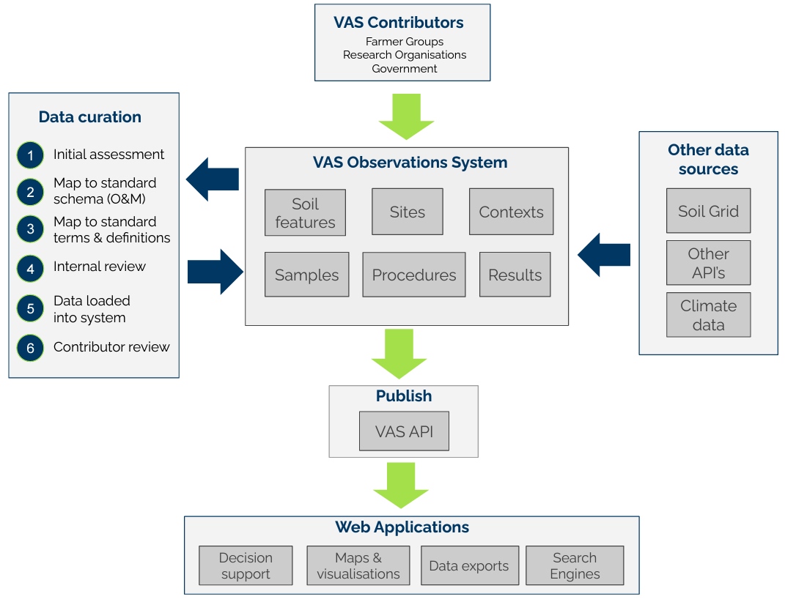

Slide 8
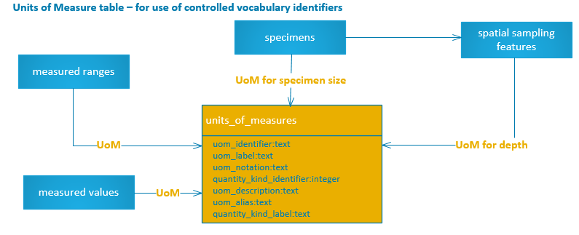

Slide 9
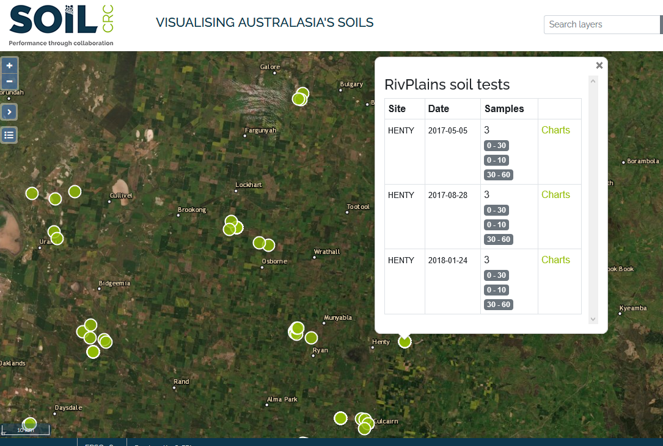
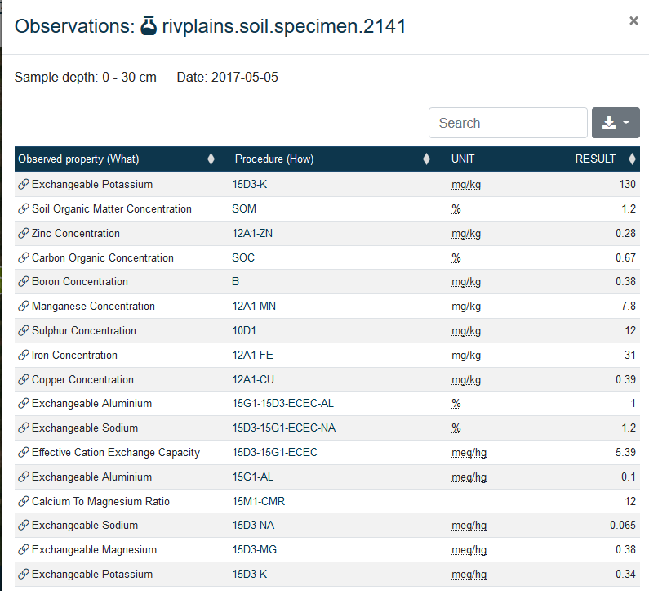
Notes:
In development so prob changed by now,
But you can see - 3 observations made at three different depths, at the same locations.
Click on a soil layer, here 0 – 30 – you will get an observable property – what is being measured, the procedure used to make the observation, and the unit of measure the observation was made in. All three of these should lead off to a controlled vocabulary term, then you have the result

Slide 10
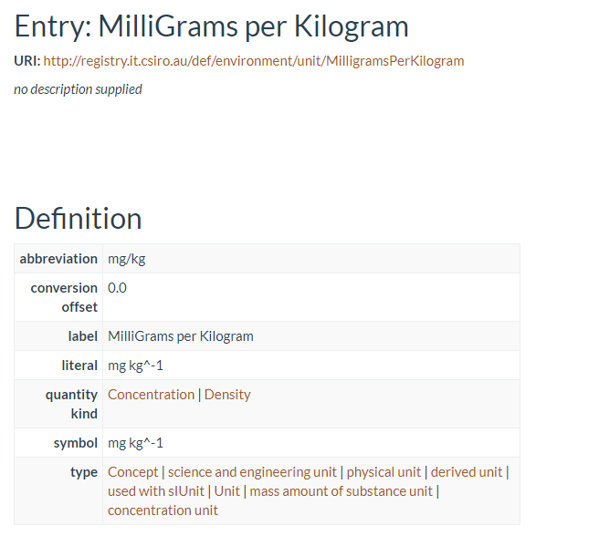
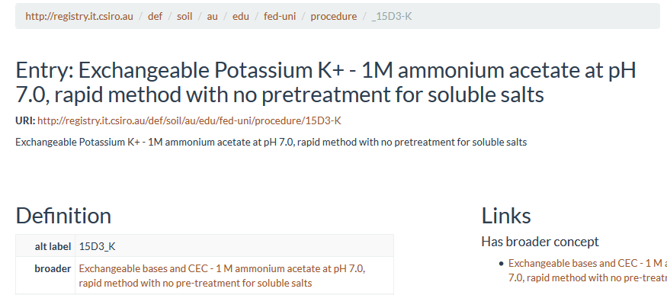
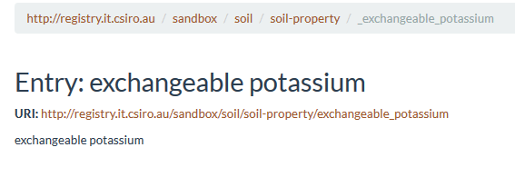
(note – there have been updates to vocabs used here)
Notes:
A bit date, a number of updates we need to make –
For example mg/kg should

Slide 11

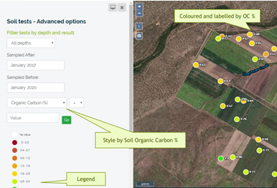
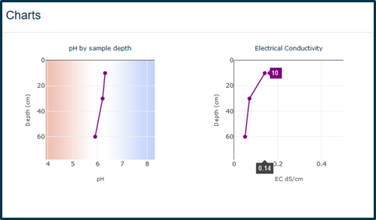
In development: Trends across time and at depth, advanced filtering, reporting, downloading options
The challenge of multiple audiences for interface (but primarily grower group)
What will grower groups used to seeing on their test result sheet/understand?
Scientifically correct?
Ok from soil information/O&M perspective?
e.g. in this version:
‘Samples’ – are actually the Feature of Interest ‘Soil Layer’ – what should label be?
Soil Organic Carbon % - What is this? the method? The observed property? The chemical entity? What if I want to search by ppm?
Compromise required
grower group feedback underway
Notes:
There are a number of things in interface that need work here.
We are always balancing the tension between what is scientifically correct and correct from an observations and measurement and informatics viewpoint, to what the user is used to seeing
For example, you would argue ‘sample’ is not infact sample but the feature of interest ‘soil layer’. A user may say what is a ‘soil layer’? Aren’t these my samples?
The provider is used to seeing ‘soil organic carbon %’. We are like, are you filtering results by a test called ‘Soil Organic Carbon’ or is this the observed property of soil organic carbon? Split UoM out, what if I want to just select all SOC measurement in % v ppm?

Slide 12
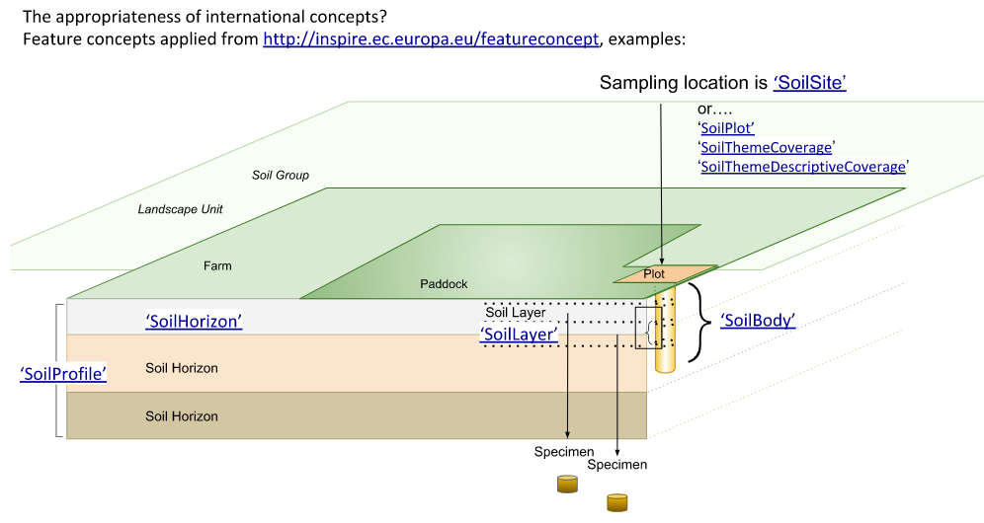
Feature type vocabularies -
  http://inspire.ec.europa.eu/featureconcept - INSPIRE terms
  Interpretation/how we apply the terms: currently a bit of moving feast.
    E.g.s use of soil body, how we describe the spatial sampling feature (point, plot, paddock, farm…)
Relationship types and role vocabularies - to describe relationship types and roles between features in space and over time
  Used RO Ontologies - an ontology of relations for use with biological ontologies
  Some challenges interpreting/selecting, and then applying the terms consistently as new data comes in
Feature sampling method – challenge finding specific to soils
  Selected from sampling method collection of GS Soil Thesaurus ISO 11074
    General Q encountered: Apply concepts by the appropriateness of their definition or based on collection it is in?
      ‘depth related sample’ – “sample collected at a predefined depth…”
      ‘core’ – “more or less cylindrical section of soil or rock….”
‘spatially disjoint’
‘spatially co-extensive’
‘Part of’
‘Located in’
Notes:
Paddock = Spatial Sampling Feature
Sampling location (site/pit) = Spatial Sampling Feature
Soil Profile and Soil Horizons = Features of Interest
Soil Bodies and Soil Layers = Features of Interest
Soil Sample = Specimen

Slide 13
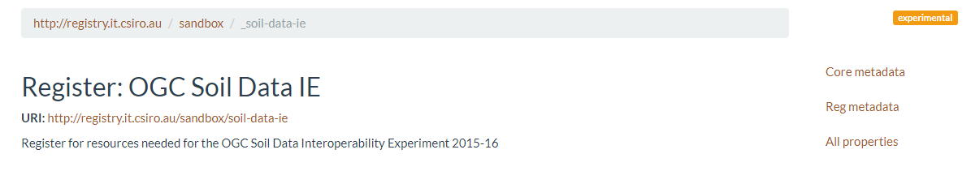
Vocabulary selection: Persistence, maintenance and authority
How do we know the vocabulary we are applying:
Is persistent and trusted?
Is being actively governed, preferably by an authoritative body?
We make best judgement calls. Vocabularies/ontologies –
Appear to be a formalised, versioned and governed ontology rather than project or experiment based
Example: Where possible we have avoided using ‘experimental’ OGC Soil Data Interoperability experiment vocabularies

Slide 14
Some of our general rules for vocabulary selection, continued……
Preferably has a definition (that matches what you are trying to describe)
It is what you are trying to describe, example:
  To describe an observed property it should be from a collection ‘properties’ or similar, substance, from ‘substance’ or ‘object’ collection, procedure from a ‘procedures’ collection
Correct context based on hierarchy it sits in - 'respiration’ with definition 'process of respiration of plants generating CO2’ – a soil microbe does not do this
Are re-used in other ontologies? may indicate reputability? and increase the ability to be able to link data across datasets through semantic web, someday…..?
That gives a human readable definition as well as machine readable (ie a human can read the term on a webpage)
Try to use the the URI 'source of truth' address for the controlled vocabulary (not the https of the term in a vocabulary register, for example)

Slide 15







Where are they? Everywhere there are vocabs, vocabs ……
How do we know if we really need to create a new vocabulary?
In general, quick service search approach:
and….
???....
e.g

Slide 16
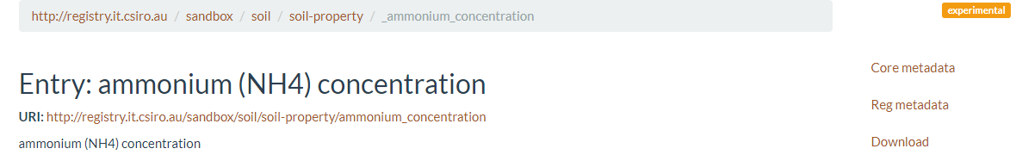

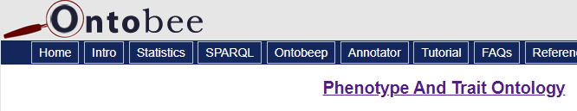
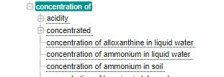
Observable properties: Few vocabularies for
Use from experimental? Currently no governance of and not stable. These are what we are using, temporary
Or do we use from another domain ontology?
Does not need to be soil specific eg concentration in soil
Example, ammonium concentration -
Or…..

Slide 17
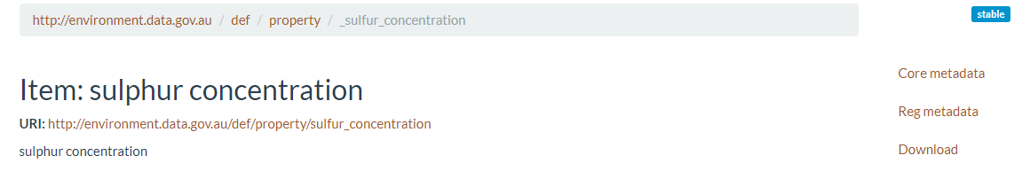
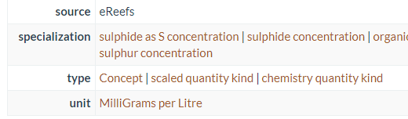
Observable properties: challenges continued - UoM
We measure this in ppm, mg/kg, other UoM
Does the unit here matter, or can we use this vocab (ie does the concept ‘sulfur concentration’ stand independent of UoM’?

Slide 18
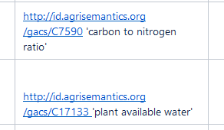
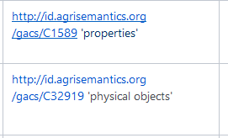
Observable properties: challenges continued – is this an observed property??
What vocabularies can I use to describe observed properties of soil? For example -
Alright I think
OK, I’ll use this:
Top concepts:
Hmm, maybe not

Slide 19
Collections the vocabularies are coming from are many, e.g. -
Observable properties
http://registry.it.csiro.au/def/environment/property ‘property’ > phosphorus concentration’
http://registry.it.csiro.au/def/soil/au/asls/soil-prof ‘soil colour’
http://registry.it.csiro.au/def/soil/au/edu/fed-uni/property our ‘property’>’recalcitrant carbon concentration
http://registry.it.csiro.au/def/agriculture/cabi – list of terms for CABI>’buffering capacity’
http://aims.fao.org/aos/agrovoc/c_2283 ‘dimensions’ > ‘depth’ ‘soil water content’
http:/id.agrisemantics.org/gacs/C1589 ‘properties’>’carbon to nitrogen ratio’
http://purl.obolibrary.org/obo/GO_0008150 'biological processes’>’anaerobic respiration’
http://aims.fao.org/aos/agrovoc/c_49874 ’properties’>’composition’
http://purl.jp/bio/4/subject/IA14 ’resources and energy’>’biological mass’
http://purl.jp/bio/4/subject/IA07 ‘phenomena’>’nitrogen fixation’
http://aims.fao.org/aos/agrovoc/c_330704 ‘phenomena’> ‘nitrification’
Species, substances or object
http://purl.obolibrary.org/obo/BFO_0000001 Thing>'Entity’>’microbial community’
http://purl.obolibrary.org/obo/CHEBI_24431 ‘Chemical entity’ > ‘carbon dioxide’
http://purl.jp/bio/4/id/200906079942882108 ‘organism’> ‘vesicular arbuscular mycorrhizal fungi“
http://purl.obolibrary.org/obo/NCIT_C14250 Thing>’organism’ >’protozoa’
http://id.agrisemantics.org/gacs/C32916 ’object’ >’organism’>’mycorrihizal fungi’

Slide 20
Soil processes relating to the living soil, across various ontologies, eg -
Interlinking Ontology for Biological Concepts
Biological processes and interactions
PATO - the Phenotype and Trait Ontology
MICRO - a limited number of terms to help describe microorganisms that live in the soil
OHMI: Ontology of Host-Microbiome Interactions. OHMI is a biomedical ontology that represents the entities and relations in the domain of host-microbiome interactions.
Gene Ontology - useful for some biological related processes in the soil e.g. Nitrogen fixation

Slide 21
Challenges of describing which vocabs to use: The case of soil biology
Could we go abstract to reduce the number of observed properties we need to find/use/create? E.g. have used ‘composition’ and ‘biomass’ (but not ‘concentration of’
It is a bit unclear what the observed property even is, particularly with ‘proxy’ or ‘indicator’
What will be most useful and to whom?
An example -
provider label | procedure member label | obsv property | substance
Microbial,activity indctr | Microbial activity by CO2 respiration - 3 days laboratory | anaerobic respiration' | ‘carbon dioxide’
Resprtn*,mg CO2/kg | Microbial basal respiration by CO2 production - 3 days laboratory. | anaerobic respiration' | ‘carbon dioxide’
Soil Micro,Biomass C mg C/kg | Soil microbial biomass by CO2 respiration - 3 days laboratory. | anaerobic respiration' | ‘carbon dioxide’
N,minrlz'n mg/kg | Mineralisable nitrogen by CO2 - 3 days laboratory. | anaerobic respiration' | ‘carbon dioxide’
P,minrlztn mg/kg | Mineralisable phosphorus by CO2 - 3 days laboratory. | anaerobic respiration' | ‘carbon dioxide’
Soil Basal Respiration 7-28 day mg C/kg soil | Soil basal respiration by CO2 - 7 - 28 days laboratory. | anaerobic respiration' | ‘carbon dioxide’

Slide 22
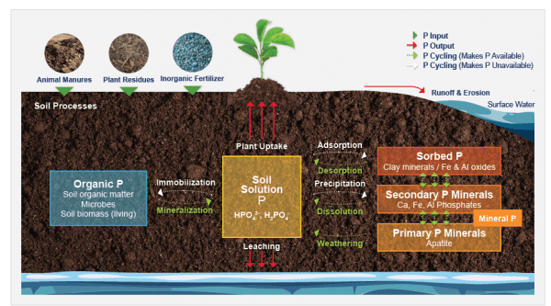
Example of mapping challenge: Soil phosphorus results from soil biological laboratory
Result column headers from provider:
"Net P release mg/kg/month"
"P fertiliser availability %"
"P release from Total P % "
"Total P mg/kg "
Exactly which soil P process is being measured? With a standard or citable method?
Exactly which compound/form of soil P is being measured?
What degree of resolution/accuracy is required by (and understandable by) audience?
Level of/expertise area of data manager/broker, maintenance, revision
Soil related process and their substances (and procedures use to make the observations) not related to eachother in ontologies (Q -perhaps in some - eg soil C?)
? "phosphorus molecular entity" http://opendata.inra.fr/EOL/EOL_0001820
?"soil phosphorus compound" http://opendata.inra.fr/EOL/EOL_0001820
We are using quite generic for most "phosphorus atom" http://purl.obolibrary.org/obo/CHEBI_28659
https://www.aces.edu/blog/topics/crop-production/understanding-phosphorus-forms-and-their-cycling-in-the-soil/

Slide 23
Current approach and considerations: Controlled vocab creation
To CSIRO Linked Data Registry via Excel2LDR or UI
Created – Concepts that do not exist elsewhere (or may exist elsewhere but not yet found!), particularly:
  Asserted values (classifiers)
  Soil chemical procedure vocabularies, Soil Chemical Methods of Australasia (with CSIRO)
Considerations (current and future)
Upskilling, time and effort
Domain expertise required: Balancing service work with academic output requirements
URIs unique, prefix reflecting governance arrangements
Governance and creation, and ongoing governance of: Whose role for which vocabularies
  Consideration of institutional priorities, roles, responsibilities, resourcing, knowledge and skills
    Including National level governance bodies, IP holders, the wider Aust soil community, global soil community, generalist/earth obsv communities, individual organisations and institutions
Trialling of vocab creation, update, management tooling that is ‘low bar’ for non-semantic experts (well maintained, documented, help available/user community)

Slide 24

Unit of measure
Try to map to units as given by provider/that they are used to seeing
Some providers don’t give units – no entry – back to provider (time consuming)
We never create our own UoM vocabularies!
Updating to QUDT v.2.1.2 http://www.qudt.org/doc/DOC_VOCAB-UNITS.html
  Primarily maintenance environment is a public GitHub repository https://github.com/qudt/qudt-public-repo
  Some have been added as GitHub pull-requests, e.g:
    kg/ha
    Quantity kinds: 'volume fractions' of w/w, w/v, v/v (received as %)
A lot of labs still use Milliequivalent/100g instead of cmol/kg
  'equivalent' has been requested
  cmol/kg also requested
  Thanks for assistance Simon :)

Slide 25
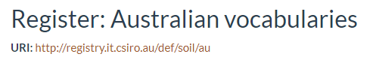
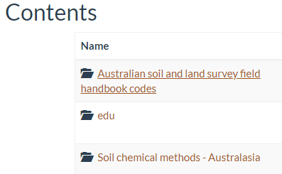
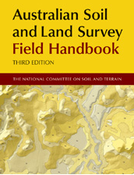
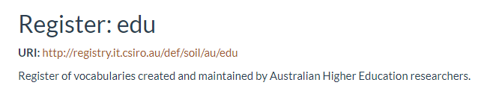
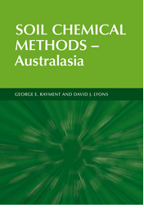

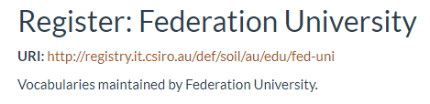
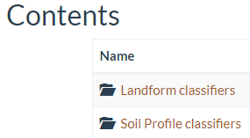
(Note - registers and URIs reflecting governance arrangements)
Soil Chemical Methods Australasia 1. (2011), by George E Rayment and David J Lyons. CSIRO publishing
L.Gregory, S.Cox
Notes:
https://confluence.csiro.au/public/VOCAB/vocabulary-formalization-and-conversion/case-specific-examples/australian-soil-and-land-survey-field-handbook-yellow-book
The Australian Soil and Land Survey Field Handbook comprises a series of chapters, each of which
describes a set of classifiers for some aspect of soil or landscape classification
was written by specified authors
In order to facilitate their use in linked datasets, each classifier (term, code) should have its own URI. From the point of view of governance, each chapter is considered independently.

Slide 26
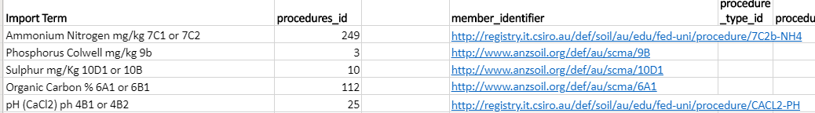

Soil chemical procedures: Challenges and solutions from provider data examples
Example 1
Provider clarified - green book code ‘7C2b’
More than one green book code provided
generic procedure code created
(NB Should species measured part of the procedure code? )
Example 2
Multiple carbon procedures used
Not clearly green book method/code
Clarified with provider - Not always possible with historic data

Slide 27
Soil chemical procedures: Challenges and solutions from provider data examples
Example 3 Underlying procedures, with additional calculations. Hard/difficult to know what to capture and how best to describe w procedure vocab, eg CEC and ECEC, various ratios w underlying procedures
A combination of procedure (15E1) and calculation (Mg as % total cation capacity)
Indicates this procedure is a calculation based on results from a lab method
Example 4 Non ‘standard’ green book methods
Not a green book method
Provider confirms a different method. Vocabulary created for ‘Aluminium - by Bromfield method (1987)’
Example 5 Extensions of a standard or collection?
http://registry.it.csiro.au/def/soil/au/edu/fed-uni/procedure/6C1POCa | 6C1POCa | Particulate organic C (POC) - by MIR
http://registry.it.csiro.au/def/soil/au/edu/fed-uni/procedure/6C1HUMa | 6C1HUMa | Organic Carbon as humus or decomposed materials - by MIR
http://registry.it.csiro.au/def/soil/au/edu/fed-uni/procedure/6C1RECa | 6C1RECa | Recalcitrant Organic Carbon - by MIR
How are extensions of managed? Or
Relationships between different provider vocabulary terms?

Slide 28
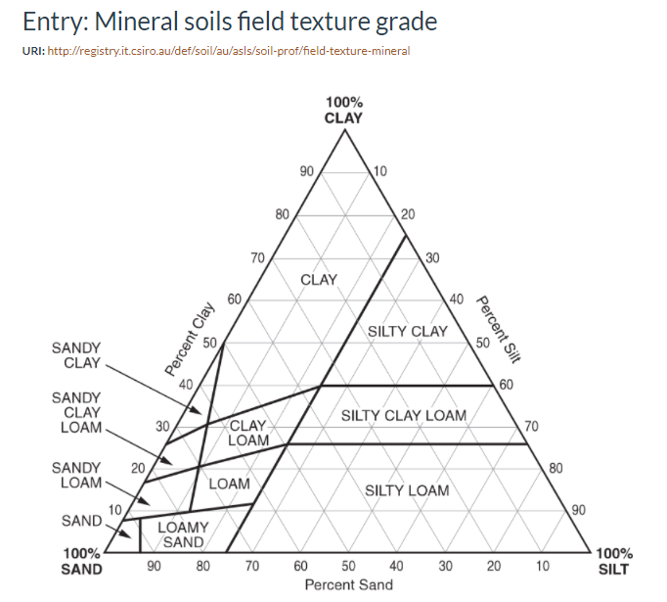



Challenges of applying Aus standard in soil profile descriptions (“the yellow book”)
Example 1 Observable property ‘texture’ – def tells us this is determined by Northcote texture triangle
Example 2 Observable Property ‘colour’ – def tells us this is determined using the Munsell Colour system
Results come in like this. Not as Munsell Colour codes -
So, how to apply these observable property and classifier vocabulary terms? ………
Results come like this. No indication of how texture was determined
Furthermore ‘clay’ is not a yellow book classifier

Slide 29
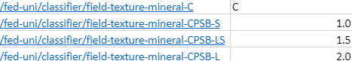
Describing soil profile data, how to? work in progress ………
Example – in describing texture data
Create own procedure?
Def 'field procedure, not specified?'
Observable properties? “Yellow book” and “non yellow book”
Classifiers?
“Yellow book” - appropriate to use if unknown classification system used?
Lab specific classification schemes

Slide 30
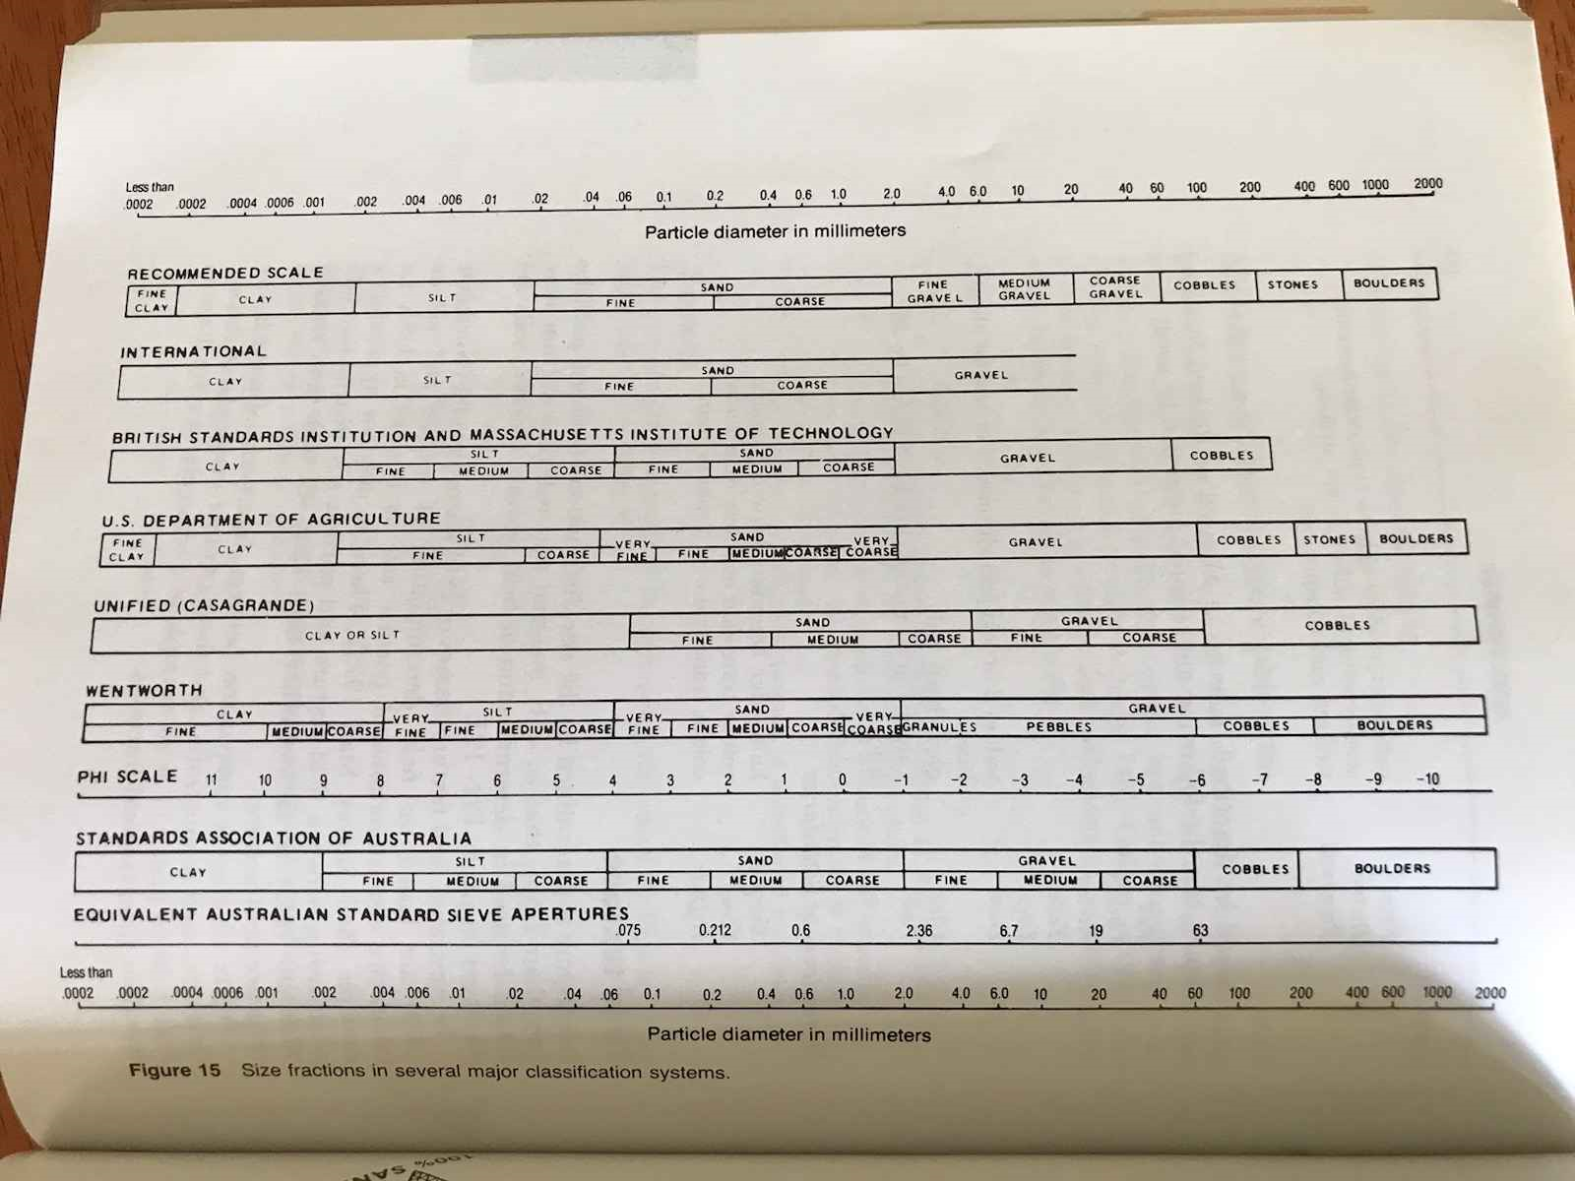
What is the object that the texture method is measuring?
trying to deal with three separate sets of concepts:
1. texture – we have standard Aust classifiers as controlled vocabularies
2. mineralogy e.g. http://purl.obolibrary.org/obo/ENVO_00002982 'clay' - 'A group of hydrous aluminium phyllosilicate (phyllosilicates being a subgroup of silicate minerals) minerals'…..
3. grain size – Need Aust Standard as controlled vocabulary

Slide 31





Standardisation of data in platforms for project stakeholders (users: farming groups, Catchment Management Authorities, researchers)
Data standardisation: Interoperability, not re-inventing wheels
  Collaboration and Communitions, consider priorities and roles of:
    International soil data communities
    National, State and Territoriy agencies
    Governing bodies (e.g NCST)
    Communities (e.g. Soil Science Aust)
    National tooling/service/data support and education (Australian Research Data Commons, Research Vocabularies Australia)
    Institutes and industry, data users and their needs
E.g. Australia/Nationally:
Thank you to CSIRO with vocabulary assistance, discussions
Thank you to those whose work this is building on
Notes:
For the first time, more than 400 laboratories in 127 countries are working together to harmonise data and methods for soil analysis so that soil data and information are comparable and interpretable by all laboratories, countries and regions
The SIMPLE database is a product of a larger programme - GLOSOLAN - a result of a unique, international collaboration led by FAO’s Global Soil Partnership.

Slide 32



















VISUALISING AUSTRALASIA’S SOILS
A Soil CRC interoperable spatial knowledge system

Slide 33
https://data.soilcrc.com.au/map/about
Soil monitoring network and soil health knowledge base
https://www.ccmaknowledgebase.vic.gov.au/soilhealth/
https://www.agrefed.org.au/
Data Policies etc – AgReFed Zenodo community

Slide 35


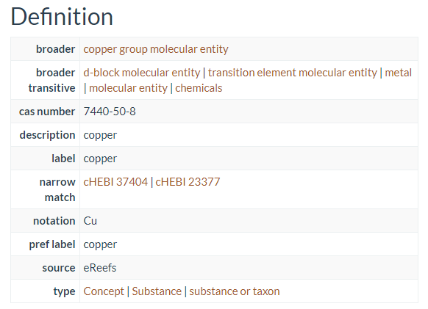
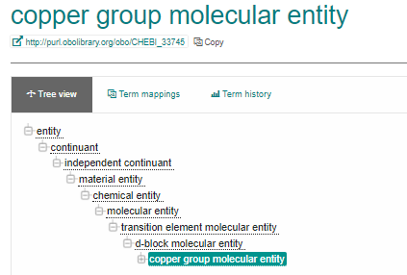
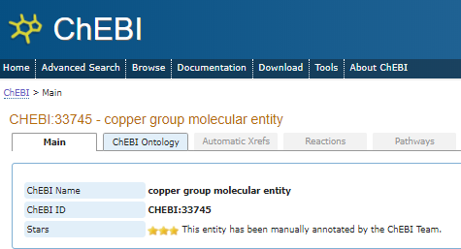
What level/resolution of species, object or substance to use?
Used from environment.data.gov.au and LDR sandbox (should use source if/as available)
Reputable and governed
http://environment.data.gov.au/def/object/copper
should be using

