Slide 1
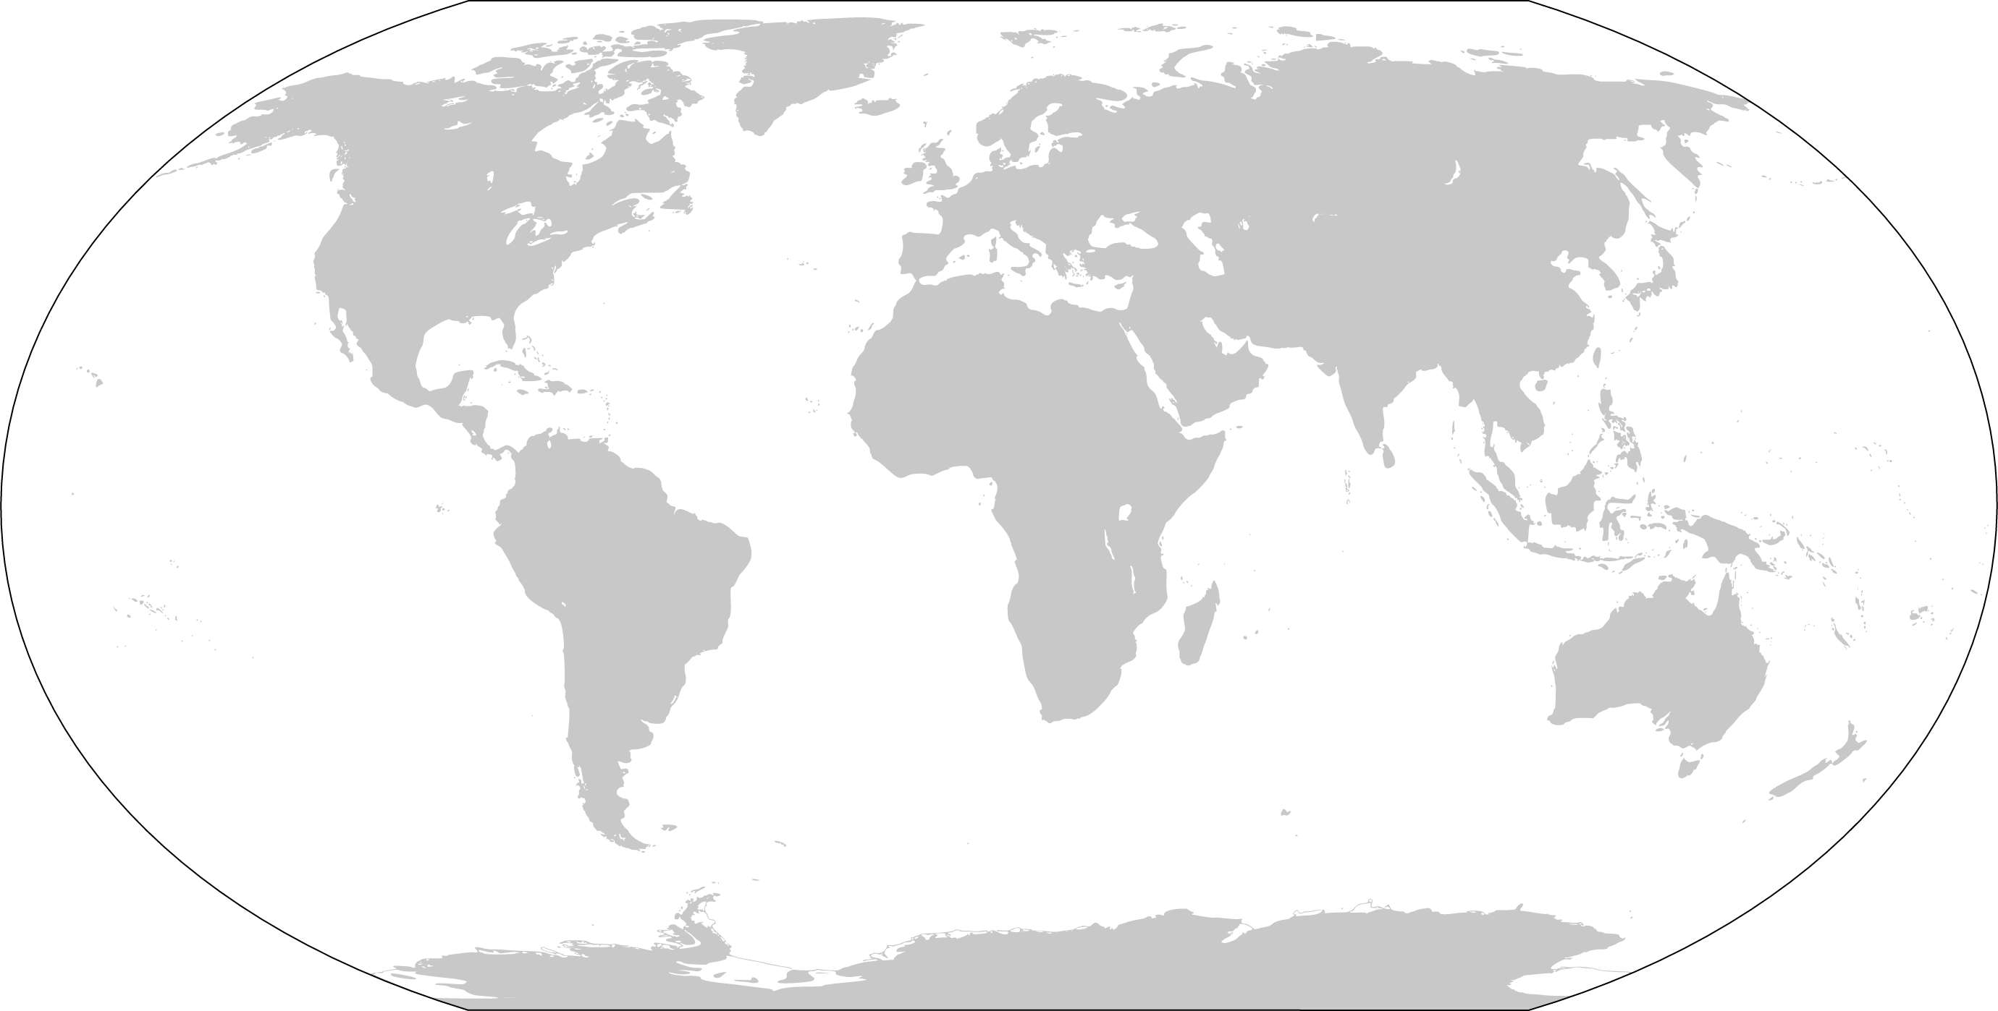
A COMMITMENT TO INDIGENOUS DATA SOVEREIGNTY SPANS THE GLOBE
NATION-STATE BASED, INDIGENOUS LED COMMUNITIES OF PRACTICE
TE MANA RARAUNGA MAORI DATA SOVEREIGNTY NETWORK in Aotearoa/New Zealand temanararaunga.maori.nz
UNITED STATES INDIGENOUS DATA SOVEREIGNTY NETWORK usindigenousdata.org
MAIAM NAYRI WINGARA INDIGENOUS DATA SOVEREIGNTY COLLECTIVE in Australia miaimnayriwingara.org
FIRST NATIONS INFORMATION GOVERNANCE CENTRE in Canada fnigc.ca
INTERNATIONAL NETWORKS OF NETWORKS
GIDA Global Indigenous Data Alliance gida-global.org
Research Data Alliance hosted INTERNATIONAL INDIGENOUS DATA SOVEREIGNTY INTEREST GROUP https://www.rd-alliance.org/groups/international-indigenous-data-sovereignty-ig

Slide 2
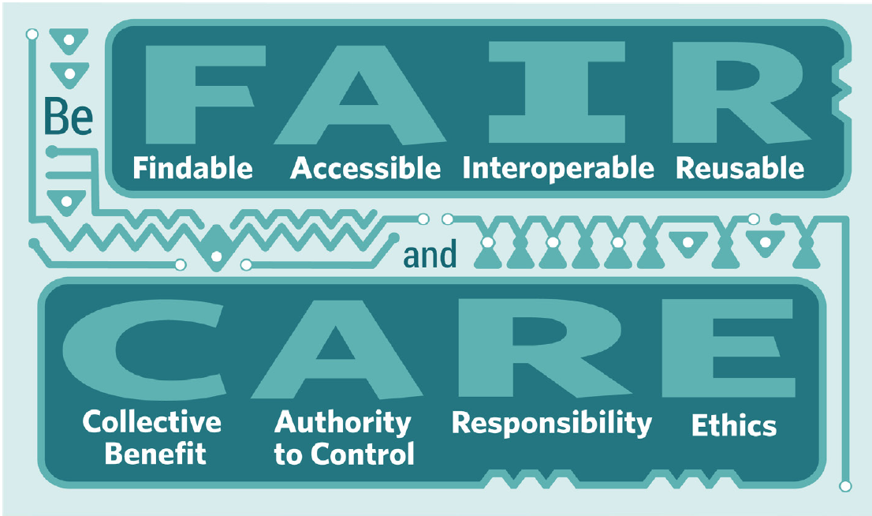

Slide 3
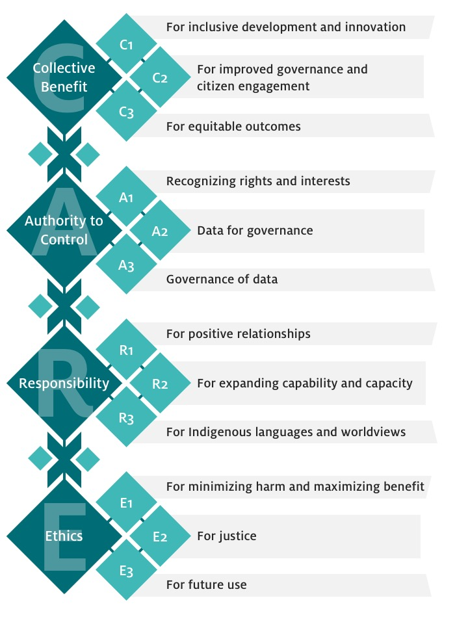
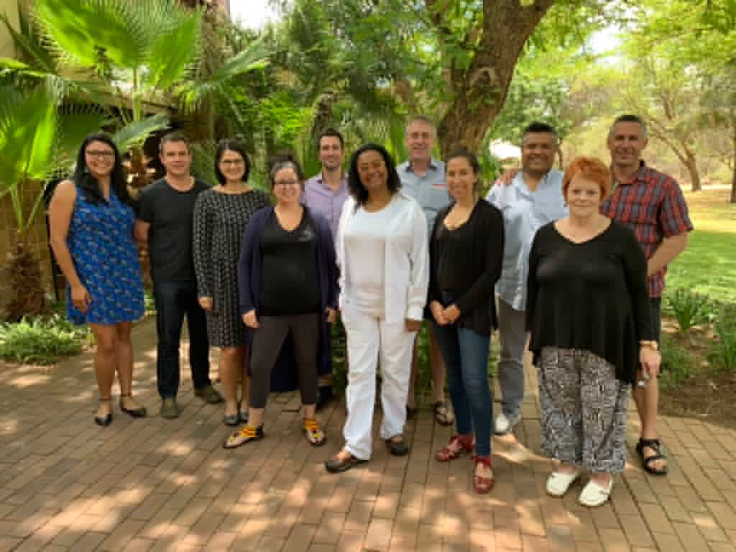
Indigenous Frameworks
CARE Principles for
Indigenous Data Governance
Carroll, SC, Garba, I, Figueroa-Rodríguez, OL, Holbrook, J, Lovett, R, Materechera, S, Parsons, M, Raseroka, K, Rodriguez-Lonebear, D, Rowe, R, Sara, R, Walker, JD, Anderson, J and Hudson, M. 2020. The CARE Principles for Indigenous Data Governance. Data Science Journal, 19: 43, pp. 1–12. DOI: https://doi.org/10.5334/dsj-2020-043

Slide 4
Wilkinson, M. D. et al. The FAIR Guiding Principles for scientific data management and stewardship. Sci. Data 3:160018 doi: 10.1038/sdata.2016.18 (2016).

Slide 5
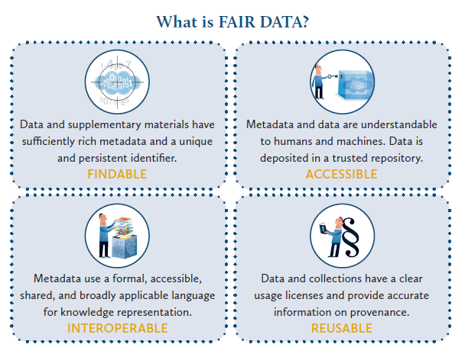
Association of European Research Libraries. (2017). Implementing FAIR Data Principles: The Role of Libraries. https://libereurope.eu/wp-content/uploads/2017/12/LIBER-FAIR-Data.pdf

Slide 7
Collective Benefit Data ecosystems shall be designed and function in ways that enable Indigenous Peoples to derive benefit from the data.
Authority to Control Indigenous Peoples’ rights and interests in Indigenous data must be recognised and their authority to control such data be empowered. Indigenous data governance enables Indigenous Peoples and governing bodies to determine how Indigenous Peoples, as well as Indigenous lands, territories, resources, knowledges and geographical indicators, are represented and identified within data.
Responsibility Those working with Indigenous data have a responsibility to share how those data are used to support Indigenous Peoples’ self determination and collective benefit. Accountability requires meaningful and openly available evidence of these efforts and the benefits accruing to Indigenous Peoples.
Ethics Indigenous Peoples’ rights and wellbeing should be the primary concern at all stages of the data life cycle and across the data ecosystem.

Slide 8
Data ecosystems shall be designed and function in ways that enable Indigenous Peoples to derive benefit from the data.
C1. For inclusive development and innovation
C2. For improved governance and citizen engagement
C3. For equitable outcomes

Slide 9
COLLECTIVE BENEFIT
C1
For inclusive development and innovation
Governments and institutions must actively support the use and reuse of data by Indigenous nations and communities by facilitating the establishment of the foundations for Indigenous innovation, value generation, and the promotion of local self-determined development processes.
For improved governance and citizen engagement
Data enrich the planning, implementation, and evaluation processes that support the service and policy needs of Indigenous communities. Data also enable better engagement between citizens, institutions, and governments to improve decision-making. Ethical use of open data has the capacity to improve transparency and decision-making by providing Indigenous nations and communities with a better understanding of their peoples, territories, and resources. It similarly can provide greater insight into third-party policies and programs affecting Indigenous Peoples.
For equitable outcomes
Indigenous data are grounded in community values, which extend to society at large. Any value created from Indigenous data should benefit Indigenous communities in an equitable manner and contribute to Indigenous aspirations for wellbeing.
C2
C3

Slide 10
Indigenous Peoples’ rights and interests in Indigenous data must be recognized and their authority to control such data respected. Indigenous data governance enables Indigenous Peoples and governing bodies to determine how Indigenous Peoples, as well as Indigenous lands, territories, resources, knowledges, and geographical indicators are represented by and identified within data.
A1. Recognizing rights and interests
A2. Data for governance
A3. Governance of data

Slide 11
AUTHORITY TO CONTROL
A1
Recognizing rights and interests
Indigenous Peoples have rights and interests in both Indigenous Knowledge and Indigenous data. Indigenous Peoples have collective and individual rights to free, prior, and informed consent in the collection and use of such data, including the development of data policies and protocols for collection.
Data for governance
Indigenous Peoples have the right to data that are relevant to their world views and empower self-determination and effective self-governance. Indigenous data must be made available and accessible to Indigenous nations and communities in order to support Indigenous governance.
Governance of data
Indigenous Peoples have the right to develop cultural governance protocols for Indigenous data and be active leaders in the stewardship of, and access to, Indigenous data especially in the context of Indigenous Knowledge.
A2
A3

Slide 12
Those working with Indigenous data have a responsibility to share how that data are used to support Indigenous Peoples’ self-determination and collective benefit. Accountability requires meaningful and openly available evidence of these efforts and the benefits accruing to Indigenous Peoples.
R1. For positive relationships
R2. For expanding capability and capacity
R3. For Indigenous languages and worldviews

Slide 13
RESPONSIBILITY
R1
For positive relationships
Indigenous data use is unviable unless linked to relationships built on respect, reciprocity, trust, and mutual understanding, as defined by the Indigenous Peoples to whom those data relate. Those working with Indigenous data are responsible for ensuring that the creation, interpretation, and use of those data uphold, or are respectful of, the dignity of Indigenous nations and communities.
For expanding capability and capacity
Use of Indigenous data invokes a reciprocal responsibility to enhance data literacy within Indigenous communities and to support the development of an Indigenous data workforce and digital infrastructure to enable the creation, collection, management, security, governance, and application of data.
For Indigenous languages and worldviews
Resources must be provided to generate data grounded in the languages, worldviews, and lived experiences (including values and principles) of Indigenous Peoples.
R2
R3

Slide 14
Indigenous Peoples’ rights and wellbeing should be the primary concern at all stages of the data life cycle and across the data ecosystem.
E1. For minimizing harm and maximizing benefit
E2. For justice
E3. For future use

Slide 15
ETHICS
E1
For minimizing harm and maximizing benefit
Ethical data are data that do not stigmatize or portray Indigenous Peoples, cultures, or knowledges in terms of deficit. Ethical data are collected and used in ways that align with Indigenous ethical frameworks and with rights affirmed in UNDRIP. Assessing ethical benefits and harms should be done from the perspective of the Indigenous Peoples, nations, or communities to whom the data relate.
For justice
Ethical processes address imbalances in power, resources, and how these affect the expression of Indigenous rights and human rights. Ethical processes must include representation from relevant Indigenous communities.
For future use
Data governance should take into account the potential future use and future harm based on ethical frameworks grounded in the values and principles of the relevant Indigenous community. Metadata should acknowledge the provenance and purpose and any limitations or obligations in secondary use inclusive of issues of consent.
E2
E3

